Slide 1
Chapter 8 Advanced Counting Techniques
Several Advanced Counting Techniques:
  Recurrence Relations
  Generating Functions
  The Principle of Inclusion-Exclusion

Slide 2
Chapter 8 Advanced Counting Techniques
8.1 Applications of Recurrence Relations
8.2 Solving Linear Recurrence Relations
8.3 Divide-and-Conquer Algorithms and
Recurrence Relations
8.4 Generating Functions
8.5 Inclusion-Exclusion
8.6 Applications of Inclusion-Exclusion

Slide 3
8.1 Applications of Recurrence Relations
1. Introduction
Problem:
The number of bacteria in a colony doubles every hour. If a colony begins with five bacteria, how many will be present in n hours?
A variety of counting problems can be modeled using recurrence relations.

Slide 4
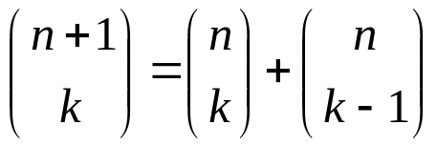
8.1 Applications of Recurrence Relations
2. Recurrence Relations （递推关系）
【Definition】 A recurrence relation for the sequence {a_{n}} is an equation that expresses a_{n} in terms of one or more of the previous terms of the sequence, namely, a₀ , a₁ , a₂ , … , a_{n-1} , for all integers n with n≥n₀,where n₀ is a nonnegative integers.
a_{n} = f ( a₀ , a₁ , a₂ , … , a_{n-1} ) n≥n₀
For example,
The Fibonacci sequence a_{n} = a_{n-1} + a_{n-2} .
Pascal's recursion for the binomial coefficient is a two-variable recurrence equation:

Slide 5
8.1 Applications of Recurrence Relations
A solution of a recurrence relation is a sequence if its terms satisfy the recurrence relation.
〖Example 1〗 Determine whether the sequence {a_{n}} is a solution of the recurrence relation a_{n} = 2a_{n-1} - a_{n-2} for n = 2,3,4,…,where a_{n} = 3n for every nonnegative integer n.
Answer the same question where a_{n} = 2^{n} and where a_{n} = 5 .
Solution :
a_{n} = 3n
a_{n} = 2^{n}
a_{n} = 5




Slide 6
8.1 Applications of Recurrence Relations
Note:
Normally, there are infinitely many sequences which satisfy a recurrence relation.
We distinguish them by the initial conditions, the values of a₀ , a₁ , a₂ , ... to uniquely identify a sequence.
Give a recurrence relation, how many initial conditions are needed to uniquely identify the sequence?
The degree of a recurrence relation
a_{n} = a_{n-1} + a_{n-8} ---- a recurrence relation of degree 8

Slide 7
8.1 Applications of Recurrence Relations
For example,
In the Fibonacci recurrence a_{n} = a_{n-1} + a_{n-2} we must specify a₀ and a₁ .
In Pascal's identity
we must specify C(1,0) and C(1,1).

Slide 8
8.1 Applications of Recurrence Relations
3. Modeling with Recurrence Relations
〖Example 2〗 Rabbits and the Fibonacci numbers
A young pair of rabbits is placed on an island. A pair of rabbits does not breed until they are 2 months old. After they are 2 months old, each pair of rabbits produces another pair each month. Find a recurrence relation for the number of pairs of rabbits on the island after n months, assuming that no rabbits ever die.

Slide 9
8.1 Applications of Recurrence Relations
Solution :
f_{n} : The number of pairs of rabbits after n month
f₁ = 1
f₂ = 1
f₃ = 1+1 = 2
f₄ = 2+1 = 3
……
f_{n} = f_{n-1} + f_{n-2}

Slide 10
8.1 Applications of Recurrence Relations
〖Example 3〗 The Tower of Hanoi
H_{n} = 2H_{n-1} + 1
= 2(2H_{n-2} + 1) + 1
= 2²H_{n-2} + 2 + 1
= 2²(2H_{n-3} + 1) + 2 + 1
= 2³H_{n-3} +2²+ 2 + 1
= …
= 2^{n-1}H₁+ 2^{n-2} +…+ 2 + 1
= 2^{n-1}+ 2^{n-2} +…+ 2 + 1
= 2^{n} - 1
Solution :
Let H_{n} denote the number of moves needed to solve The Tower of Hanoi problem with n disks
H₁ , H₂ , … , H_{n} , …
H_{n} = 2H_{n-1} + 1
H₁ = 1
How to solve this recurrence relation?
Method: Use an iterative approach

Slide 11
7.1 Recurrence Relations
〖Example 4〗Find a recurrence relation for the number of bit strings of length n that don’t have two consecutive 0s.
Solution :
Let a_{n} denote the number of bit strings of length n that don’t have two consecutive 0s.
Any bit string of length n-1 with no two consecutive 0s.
1
a_{n-1}
Any bit string of length n-2 with no two consecutive 0s.
1
0
a_{n-2}
Recurrence relation:
a_{n} = a_{n-1} + a_{n-2} .
Initial conditions: a₁=2, a₂=3

Slide 12
7.1 Recurrence Relations
〖Example 5〗Codeword Enumeration: A computer system considers a string of decimal digits a valid codeword if it contains an even number of 0 digits. Let a_{n} be the number of valid n-digit codeword. Find a recurrence relation for a_{n}.
a_{n} =9 a_{n-1} +(10^{n-1}- a_{n-1})
even 0 + (1-9)
odd 0 + (0)

Slide 13
Homework: (Due on April 22)
Sec. 8.1: 24, 26, 42, 45, 48

Slide 14
Chapter 8 Advanced Counting Techniques
8.1 Applications of Recurrence Relations
8.2 Solving Linear Recurrence Relations
8.3 Divide-and-Conquer Algorithms and
Recurrence Relations
8.4 Generating Functions
8.5 Inclusion-Exclusion
8.6 Applications of Inclusion-Exclusion

Slide 15
8.2 Solving Linear Recurrence Relations
The Methods of Solving Recurrence Relations
  Iterative approach
  Generating functions
  Use a systematic way to solve an important class of
  recurrence relations
Solving recurrence relations can be very difficult unless the recurrence equation has a special form.

Slide 16

8.2 Solving Linear Recurrence Relations
Linear homogeneous recurrence relation of degree k with constant coefficients
where c₁, c₂,…, c_{k} are real numbers, and c_{k} ≠0
A sequence satisfying the recurrence relation in the definition is uniquely determined by the recurrence relation and the k initial conditions
a0=C0, a1= C1, … , ak-1=Ck-1

Slide 17
8.2 Solving Linear Recurrence Relations
Linear homogeneous recurrence relation of degree k with constant coefficients
linear
- linear combination of previous terms
constant coefficients
the coefficients of a_{i}s are constants
degree k
a_{n} is a function of the previous k terms of the sequence
homogeneous
If we put all the a_{i} s on the left side of the equation and everything else on the right side, then the right side is 0. Otherwise nonhomogeneous.

Slide 18
8.2 Solving Linear Recurrence Relations
〖Example 1〗
(1) a_{n} = (1.02)a_{n−1}
linear; constant coefficients; homogeneous; degree 1
(2) a_{n} = (1.02) a_{n−1} + 2^{n−1}
linear; constant coefficients; nonhomogeneous; degree 1
(3) a_{n} = a_{n−1} + a_{n−2} + a_{n-3} + 2^{n−3}
linear; constant coefficients; nonhomogeneous; degree 3
(4) a_{n} = n a_{n−1} + n² a_{n−2} + a_{n−1} a_{n−2}
nonlinear; coefficients are not constants; homogeneous; degree 2

Slide 19
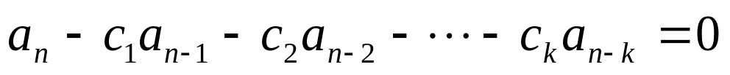
8.2 Solving Linear Recurrence Relations
1. Solving Linear Homogeneous Recurrence Relation With Constant Coefficients
The basic approach:
To look for solutions of the form a_{n} = r^{n} , where r is a constant.
Solution Procedure:
(1) Put all a_{i}s on the left side of the equation
(2) Substitute the solution into the equation, factor out the lowest power of r and eliminate it.

Slide 20
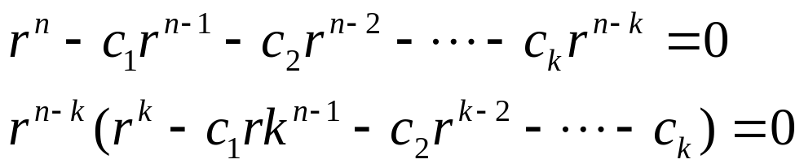

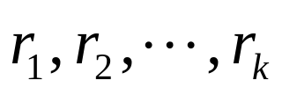
8.2 Solving Linear Recurrence Relations
Characteristic equation
(3) We obtain the equivalent equation
Characteristic root
(4) Find its k roots
These characteristic roots can be used to give an explicit formula for all the solutions of the recurrence relation.

Slide 21





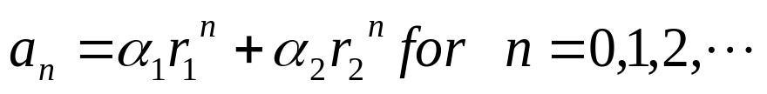

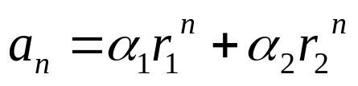
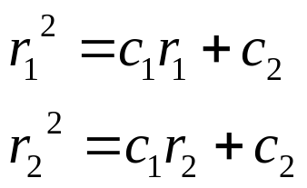
8.2 Solving Linear Recurrence Relations
【 Theorem 1】 Let be real numbers. Suppose that
has two distinct roots . Then the
Sequence is a solution of the recurrence relation
if and only if
, where are constants.
Proof:
Show that if are the roots of the characteristic equation, and are constant, then the sequence
is a solution of the recurrence relation

Slide 22

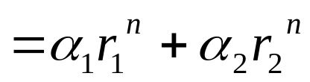
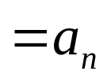
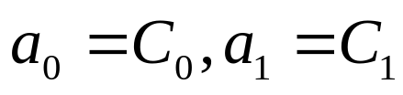
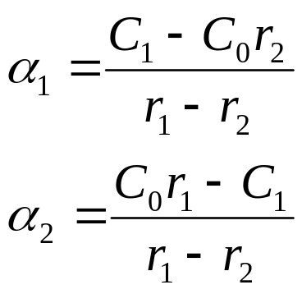
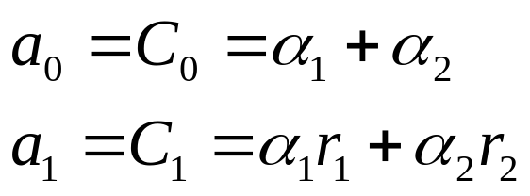
8.2 Solving Linear Recurrence Relations
Show that if is a solution, then for some constant .
Suppose that is a solution, and the initial condition
hold.

Slide 23

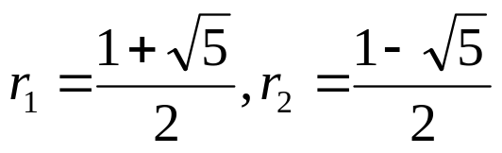
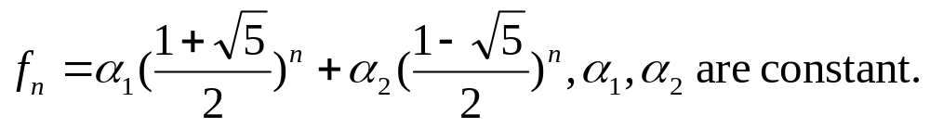
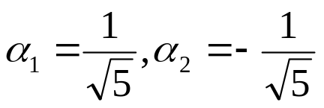
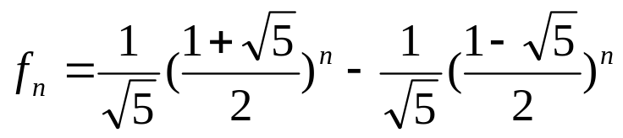
8.2 Solving Linear Recurrence Relations
〖Example 2〗Find an explicit formula for the fibonacci numbers.
Solution:
f_{n} = f_{n-1} + f_{n-2} , f₀ = 0, f₁ = 1
(1) Determine the characteristic equation:
(2) Find its roots:
(3) Obtain the general solution:
(4) Dtermine :
Consequently, the fibonacci numbers are given by

Slide 24

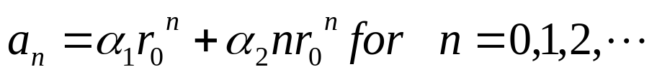

8.2 Solving Linear Recurrence Relations
【 Theorem 2】 Let be real numbers with c₂≠ 0.
Suppose that has only one root .
A sequence is a solution of the recurrence relation
if and only if
, where are constants.
Proof:
Omitted.

Slide 25




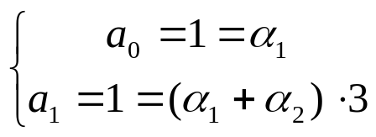
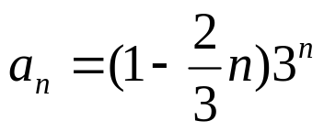
8.2 Solving Linear Recurrence Relations
〖Example 3〗
Solution:
(1) Determine the characteristic equation:
(2) Find its roots :
(3) Compute the general solution:
(4) Solve for coefficients :
Consequently,

Slide 26



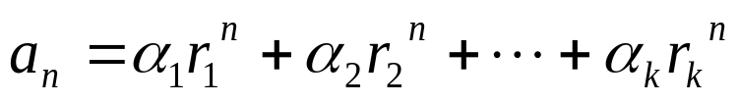



8.2 Solving Linear Recurrence Relations
【 Theorem 3】 Let be real numbers. Suppose that
the characteristic equation has k
distinct roots . Then a sequence is a solution of
the recurrence relation
if and only if
for where are constants.
The coefficients are found by enforcing the initial conditions

Slide 27
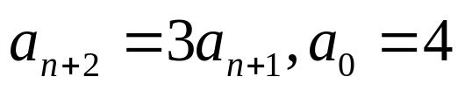



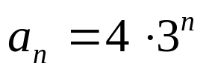
8.2 Solving Linear Recurrence Relations
〖Example 4〗 What is the solution of the recurrence relation
Solution:
The Characteristic equation of the recurrence relation is r – 3=0 .
(2) Find the root of the characteristic equation:
(3) Compute the general solution:
(4) Find the constants based on the initial conditions:
(5) Produce the specific solution:

Slide 28




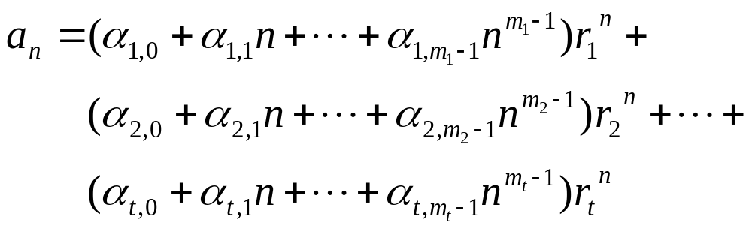

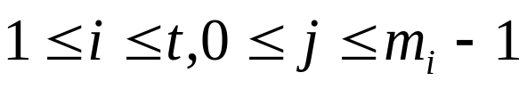
8.2 Solving Linear Recurrence Relations
【 Theorem 4】 Let be real numbers. Suppose that
the characteristic equation has t
distinct roots with multiplicities ,
respectively, so that and
Then a sequence is a solution of the recurrence relation
if and only if
for where are constants for
.

Slide 29
〖Example 〗 What is the solution of the recurrence relation
Solution:
The Characteristic equation of the recurrence relation is r – 3=0 .
(2) Find the root of the characteristic equation:
(3) Compute the general solution:
(4) Find the constants based on the initial conditions:
(5) Produce the specific solution:

Slide 30
Example
Recurrence relation:
  a_{n} = 6a_{n-1} - 11a_{n-2} + 6a_{n-3} with a₀=2, a₁=5, a₂=15
Characteristic equation: r³-6r²+11r-6=0
The distinct roots are 1,2,3 hence
  a_{n} = l₁ 1^{n} + l₂ 2^{n} +l₃ 3^{n}
Use the initial condition we find that
  l₁ =1, l₂ =-1,l₃ =2. a_{n} = 1 - 2^{n} +2 •3^{n}

Slide 31
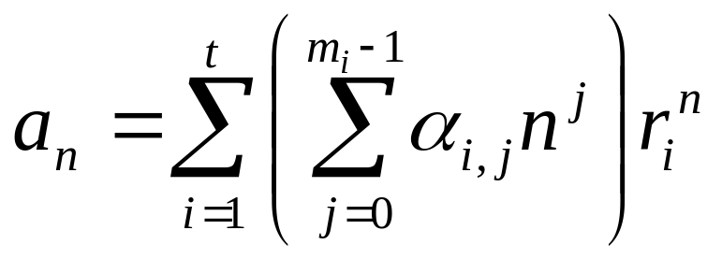
The General Case with Repeated Roots Allowed
E.g., Roots of C.E. are 2, 2, 2, 5, 5 and 9.
Solution:
(α_{1,0} + α_{1,1}n + α_{1,2}n²)*2^{n} + (α_{2,0} + α_{2,1}n)*5^{n} + α_{3,0}9^{n}

Slide 32
Example
Find the solution to the recurrence relation
a_{n} = -3a_{n-1} -3 a_{n-2} - a_{n-3} with initial condition
a₀=1, a₁ = -2, a₂ = -1
Solution: the characteristic equation is :
r³+3r² +3r + 1=0 , -1 is the single root of multiplicity 3. hence
a_{n} = (l_{1,0} + l_{1,1} n+l_{1,2} n²)(-1)^{n}

Slide 33
Cont..
Use the initial conditions, we obtain
a₀=1=l_{1,0}
a₁=-2=-l_{1,0}-l_{1,1}-l_{1,2}
a₂=-1= l_{1,0}+2l_{1,1}+4l_{1,2} solving the equation we get
l_{1,0}=1, l_{1,1}=3 and l_{1,2} =-2
Hence a_{n}=(1+3n-2n²)(-1)^{n}

Slide 34
More Example
the recurrence relation
a_{n} = 3a_{n-1}+6a_{n-2} -28a_{n-3} +24 a_{n-4}
with initial condition a₀=-2, a₁ = 12, a₂ = 22, a₃ = 222
Solution: the characteristic equation is :
r⁴-3r³ -6r²+28r-24=(r-2)³(r+3)=0,
2 is the root of multiplicity 3; and –3 is a root of multiplicity 1, then

Slide 35
Cont.
a_{n} = (l_{1,0} + l_{1,1} n+l_{1,2} n²)2^{n} + l_{2,0} (-3)^{n}
Use the initial conditions, we obtain
a₀=l_{1,0} + l_{2,0}= -2
a₁=2l_{1,0}+2 l_{1,1}+2l_{1,2} -3 l_{2,0} = 12
a₂=4l_{1,0}+8 l_{1,1}+16l_{1,2} +9 l_{2,0} = 22
a₃=8l_{1,0}+24l_{1,1}+72l_{1,2} -27 l_{2,0} = 222
solving the equation we get l_{1,0}=0, l_{1,1}=1 and l_{1,2} =2, l_{2,0}= -2 Hence a_{n}=(n+2n²)2^{n}-2(-3)^{n}

Slide 36
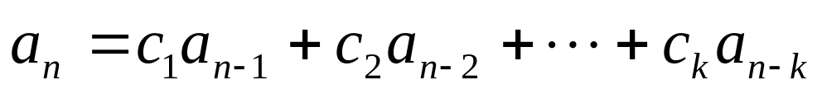
8.2 Solving Linear Recurrence Relations
2. Linear Nonhomogeneous Recurrence Relation With Constant Coefficients
Where c_{i}(i=1,2,…,k) is real numbers, F(n) is a function not identically zero depending only on n.
the associated homogeneous recurrence relation
Note:
  Solutions to nonhomogeneous case is sum of solutions to associated homogeneous recurrence system and a particular solution to the nonhomogeneous case.

Slide 37
Solving Linear Nonhomogeneous Recurrence Relations with Constant Coefficients
Theorem 5: If {a_{n}^{(p)}} is a particular solution of the nonhomogeneous linear recurrence relation with constant coefficients
a_{n} = c₁a_{n−1} + c₂a_{n−2} + ⋯ + c_{k} a_{n−k} + F(n) ,
then every solution is of the form {a_{n}^{(p)} + a_{n}^{(h)}}, where {a_{n}^{(h)}} is a solution of the associated homogeneous recurrence relation
a_{n} = c₁a_{n−1} + c₂a_{n−2} + ⋯ + c_{k} a_{n−k .}

Slide 38
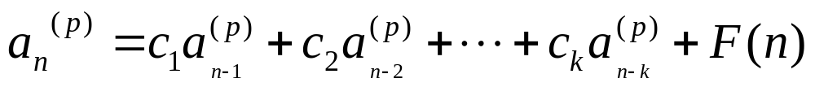
Proof:
Suppose that {b_{n}} is a second solution of the nonhomogeneous recurrence relation, so that

Slide 39
Linear Nonhomogeneous Recurrence Relations with Constant Coefficients (cont.)
The following are linear nonhomogeneous recurrence relations with constant coefficients:
a_{n} = a_{n−1} + 2^{n} ,
a_{n} = a_{n−1} + a_{n−2} + n² + n + 1,
a_{n} = 3a_{n−1} + n3^{n} ,
a_{n} = a_{n−1} + a_{n−2} + a_{n−3} + n!
where the following are the associated linear homogeneous recurrence relations, respectively:
a_{n} = a_{n−1 ,}
a_{n} = a_{n−1} + a_{n−2},
a_{n} = 3a_{n−1} ,
a_{n} = a_{n−1} + a_{n−2} + a_{n−3}

Slide 40
Solving Linear Nonhomogeneous Recurrence Relations with Constant Coefficients (continued)
Example: Find all solutions of the recurrence relation a_{n} = 3a_{n−1} + 2n.
What is the solution with a₁ = 3?
Solution: The associated linear homogeneous equation is a_{n} = 3a_{n−1}.
Its solutions are a_{n}^{(h)} = α3^{n}, where α is a constant.
Because F(n)= 2n is a polynomial in n of degree one, to find a particular solution we might try a linear function in n, say p_{n} = cn + d, where c and d are constants. Suppose that p_{n} = cn + d is such a solution.
Then a_{n} = 3a_{n−1} + 2n becomes cn + d = 3(c(n− 1) + d)+ 2n.

Slide 41
Solving Linear Nonhomogeneous Recurrence Relations with Constant Coefficients (continued)
Simplifying yields (2 + 2c)n + (2d − 3c) = 0. It follows that cn + d is a solution if and only if
2 + 2c = 0 and 2d − 3c = 0. Therefore, cn + d is a solution if and only if c = − 1 and d = − 3/2.
Consequently, a_{n}^{(p)} = −n − 3/2 is a particular solution.
By Theorem 5, all solutions are of the form a_{n} = a_{n}^{(p)} + a_{n}^{(h)} = −n − 3/2 + α3^{n}, where α is a constant.
To find the solution with a₁ = 3, let n = 1 in the above formula for the general solution.
Then 3 = −1 − 3/2 + 3 α, and α = 11/6.
Hence, the solution is a_{n} = −n − 3/2 + (11/6)3^{n}.

Slide 42
Step of solution
A. find the general form of the solution of associated homogeneous recurrence relation,say g(n)
B. find a particular solution of linear non-homogeneous recurrence with constant coefficients,say f(n)
C. use the initial condition to solve out the parameters in f(n)+g(n)

Slide 43
The key problem
The key problem is how to find a particular solution to a linear non-homogeneous recurrence with constant coefficients.
We cannot always “guess” the particular solution, but if f(n) is the product of a polynomial in n and the nth power of a constant, we know exactly what form a particular solution is.

Slide 44
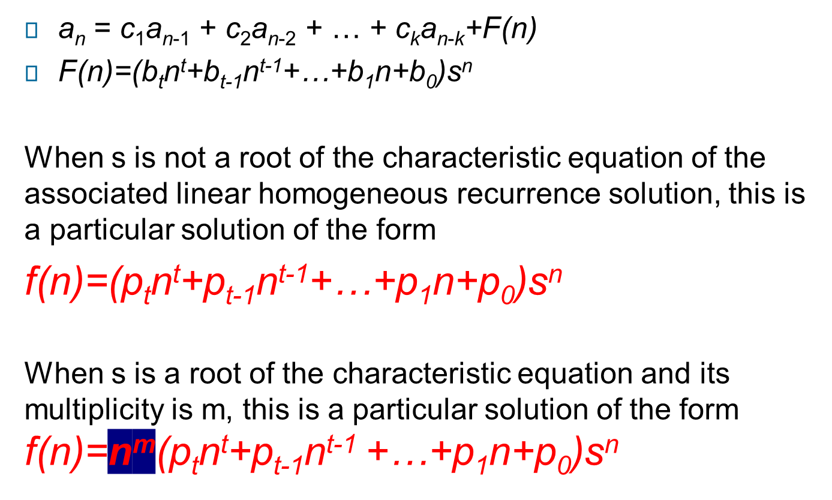
Theorem 6

Slide 45
Cont…
Example a_{n}=6a_{n-1}-9a_{n-2}+F(n) what form does a particular solution has?
(a) F(n)=3^{n}, (b)F(n)=n²3^{n}, (c)F(n)=(n²+1)3^{n}
(d) F(n)=n²2^{n}
Solution: 3 is root of characteristic equation with multiplicity 2.
(a) F(n)=3^{n}, f(n)=p₀n²3^{n}
(b)F(n)=n²3^{n}, f(n)=n²(p₂n²+p₁n+p₀)3^{n}
(c)F(n)=(n²+1)3^{n ,} f(n)=n²(p₂n²+p₁n+p₀)3^{n}
(d)F(n)=n²2^{n}, f(n)= (p₂n²+p₁n+p₀)2^{n}

Slide 46
Cont…
Example a_{n}=a_{n-1}+n, a₁=1, the general solution of its associated linear homogeneous recurrence solution is g(n)=c
Since F(n) = n =n·1^{n} and 1 is also a root of degree one of the characteristic equation, from theorem 6 there is a particular solution of the form f(n) = n· (p₁n+p₀) ·1^{n} = p₁n²+p₀n substituting it to original equation we obtain:
p₁n²+p₀n = p₁(n-1)²+p₀(n-1) + n
p₁= p₀=1/2 at last a_{n}=n(n+1)/2

Slide 47
More example
Exercise find all the solutions of recurrence relation
a_{n}=5a_{n-1}- 6 a_{n-2} +2^{n}+3n, a₀=0, a₁=1,
It can be seen two recurrence relations
a_{n}=5a_{n-1}- 6 a_{n-2} + 2^{n} and
a_{n}=5a_{n-1}- 6 a_{n-2} + 3n
the particular solutions of this two recurrence relations are: p₀n2^{n}, p₁n+p₂ respectively。
Since 2 and 3 are single roots of characteristic equation, the general solution of its associated linear homogeneous recurrence solution is g(n) = c₁2^{n}+c₂3^{n}
So the all solutions are:
a_{n}= c₁2^{n}+c₂3^{n} + p₀n2^{n}+p₁n+p₂

Slide 48




More example
Exercise solve the simultaneous recurrence relations:
a_{n}=3a_{n-1}+ 2 b_{n-1}
b_{n}=a_{n-1}+ 2 b_{n-1} with a₀=1 and b₀ =2
Solution:
So:

Slide 49
Homework: (Due on April 22)
Sec. 8.2 2, 4(g), 20, 30, 35
8th、7th

